Slide 1
Secure Data Hiding in Image Using Steganography
CAPSTONE PROJECT
Presented By: Nandini
Student Name : Nandini
College Name & Department : DAVIET , B.TECH (CSE)

Slide 2
OUTLINE
Problem Statement
Technology used
Wow factor
End users
Result
Conclusion
Git-hub Link
Future scope

Slide 3
Problem Statement
The need for secure communication has increased due to rising cyber threats.
Traditional encryption methods are often detectable, leading to unwanted scrutiny.
There is a lack of user-friendly tools that combine encryption with steganography.
A solution is required that can hide sensitive data in images while ensuring security and ease of access.

Slide 4
Technology used
Programming Language: Python
Platform: Windows 11
Libraries Used:
OpenCV (Image Processing)
NumPy (Data Manipulation)
Cryptography (Fernet Encryption)
Tkinter (Graphical User Interface)

Slide 5
Wow factors
Double-layer Security: AES-based encryption before embedding.
User-Friendly GUI: Intuitive Tkinter-based application.
Minimal Image Distortion: Uses least significant bit (LSB) technique for seamless hiding.
Cross-Platform Compatibility: Can run on Windows, Linux, and macOS.

Slide 6
End users
Cybersecurity Professionals: Secure confidential data within images.
Journalists & Activists: Covert communication to bypass censorship.
Forensic Investigators: Embed metadata in images for secure storage.
Individuals: Private messaging without attracting attention.

Slide 7
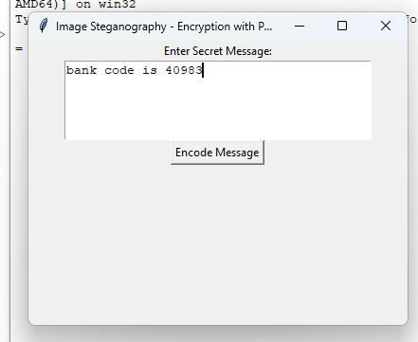
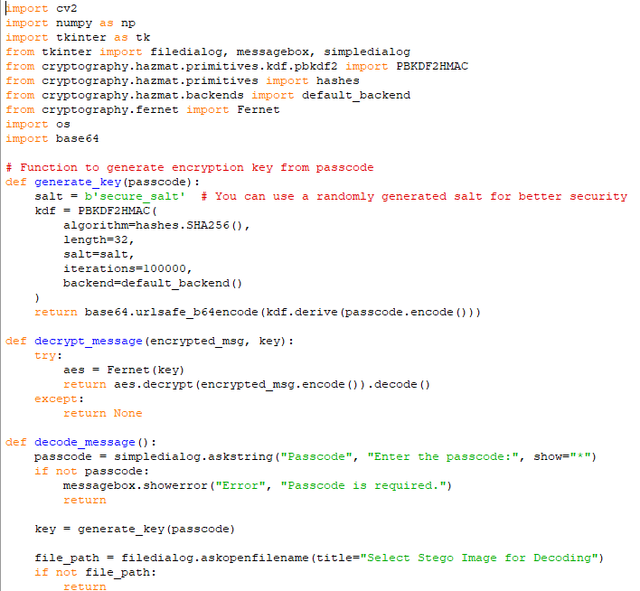
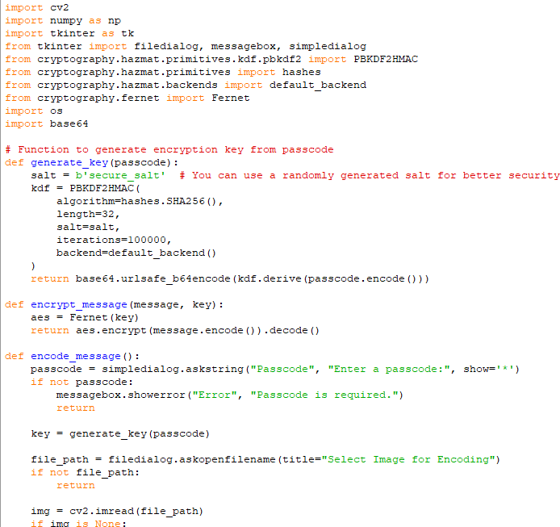
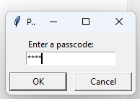
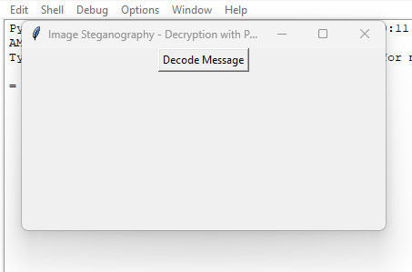
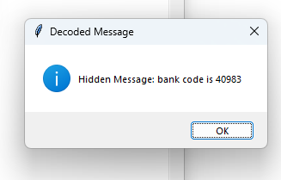


Results
GUI Interface
Decryption
Encryption
Real Image
Stegano Image

Slide 8
Conclusion
This project successfully demonstrates the use of image steganography for secure communication. By integrating cryptographic techniques with LSB-based image steganography, the system provides a robust mechanism for covert messaging. The developed tool ensures both confidentiality and ease of use.

Slide 9
GitHub Link
https://github.com/Naandini/AICTExIBM_PROJECT.git

Slide 10
Future scope(optional)
Enhanced Security: Multi-layer encryption techniques.
Audio/Video Steganography: Expanding beyond images.
Cloud-Based Integration: Secure remote storage and retrieval.
Real-time Encoding: Faster processing for instant secure messaging.

Slide 11
THANK YOU

